Slide 1
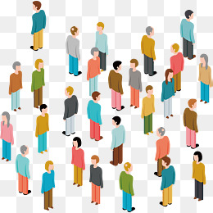
Learning Social Circles in Networks

Slide 2
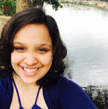
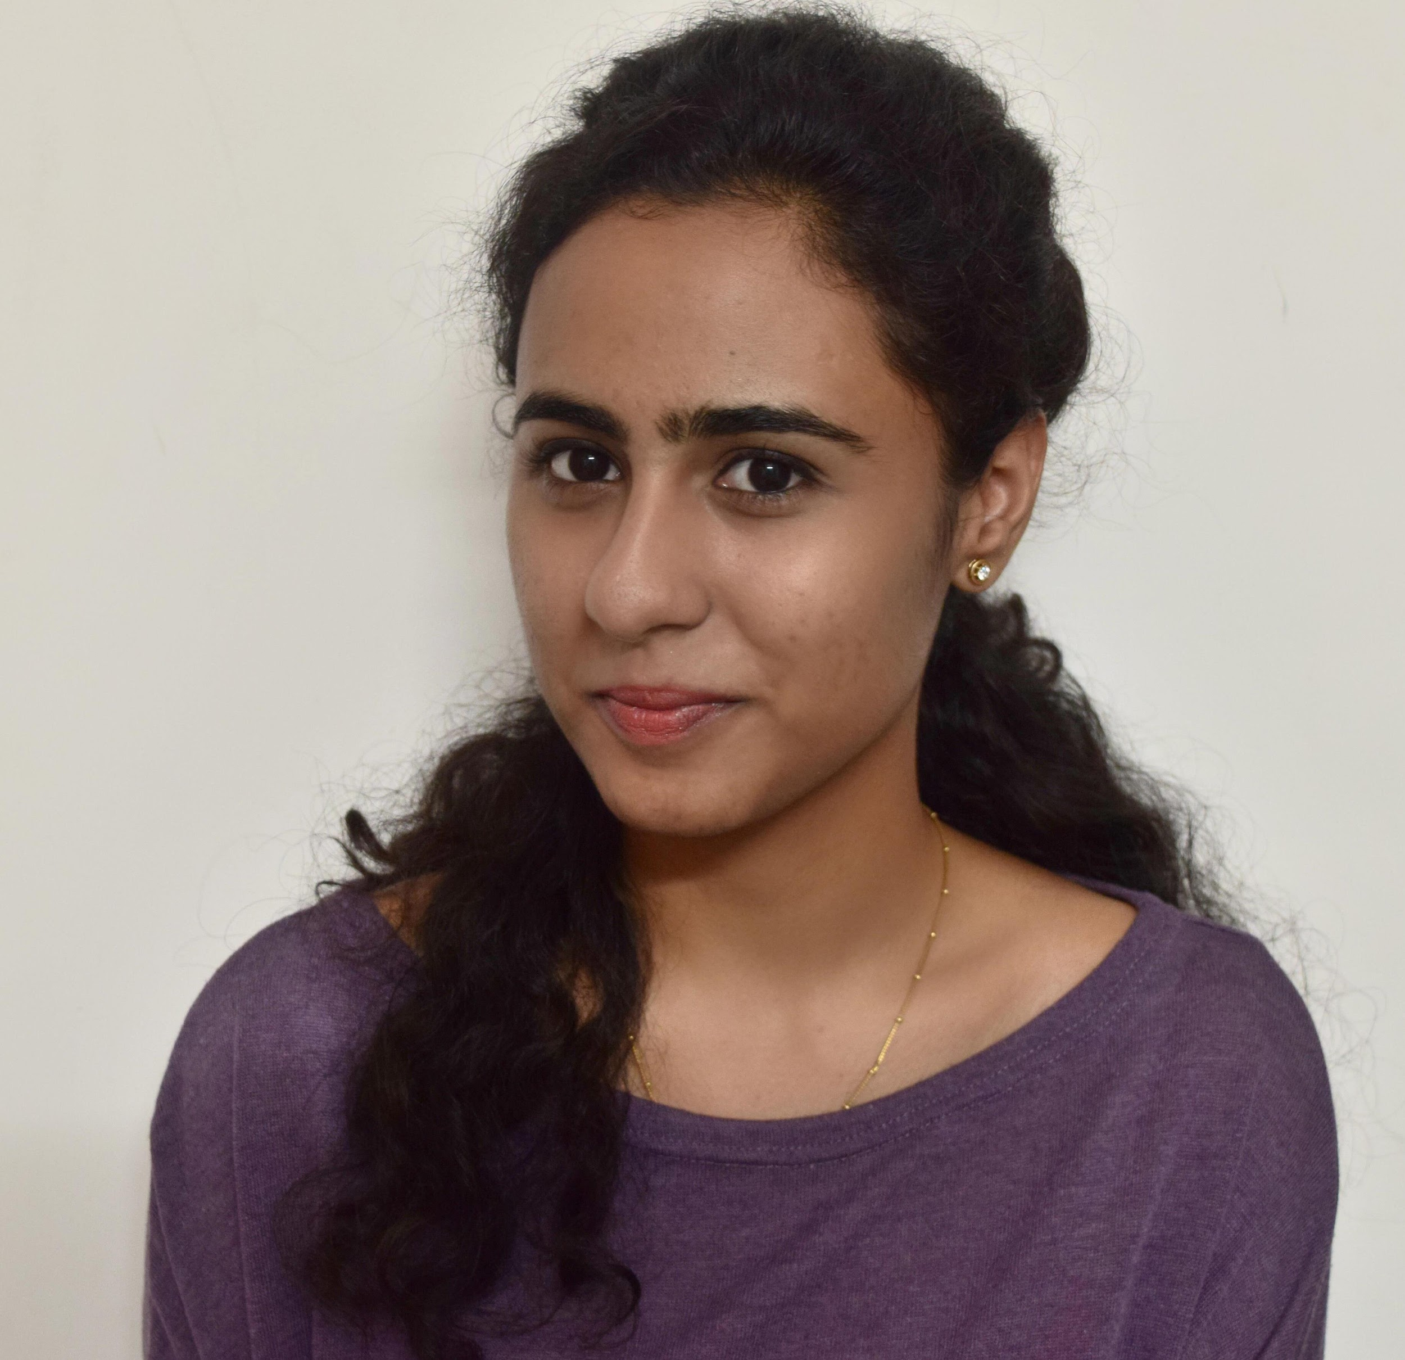
Shruti Tripathi
Business Intelligence & Analytics
Divya Rathore
Business Intelligence & Analytics
Group 10
BIA 658
Social Network Analysis

Slide 3
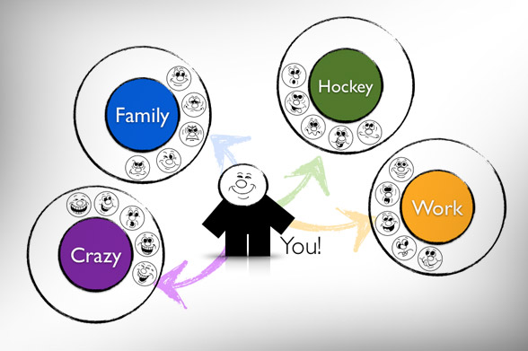
Introduction
Social networking sites allow users to manually categorize their friends into social circles however this can be a laborious task.
The goal of our project is to automatically infer users' social circles to help organize their personal social circles.

Slide 4
DATA SOURCE
https://www.kaggle.com/c/learning-social-circles

Slide 5
Data Description
Properties of circle formation:
Nodes within circles should have common properties, or ‘aspects’.
Different circles should be formed by different aspects
Circles should be allowed to overlap, and ‘stronger’ circles should be allowed to form within ‘weaker’ ones

Slide 6
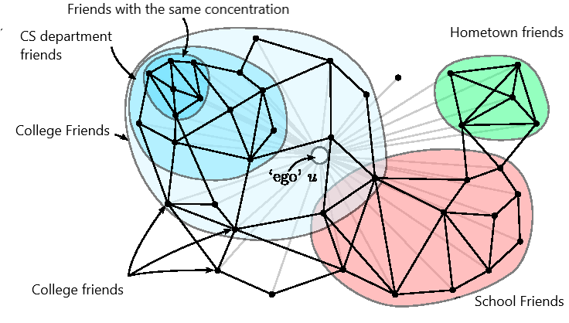

Slide 7
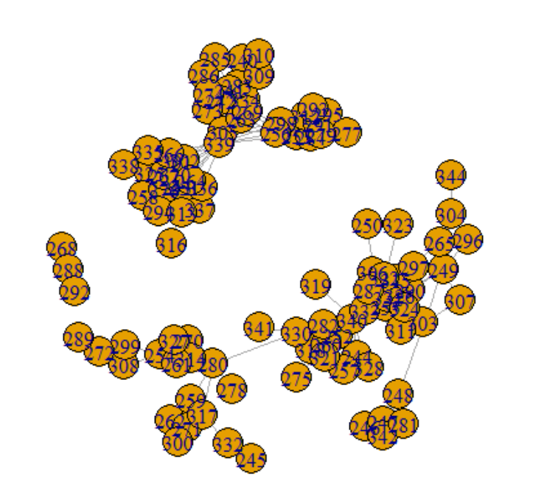
Data Description
Egonets
Each file in this directory contains the ego-network of a single user( Facebook, Google+ & Twitter), i.e., a list of connections between their friends.
Each file userId.egonet contains lines of the form UserId: Friends 1: 4 6 12 2 208 2: 5 3 17 90 7

Slide 8
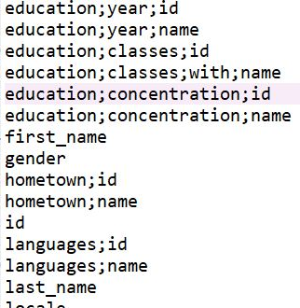
Data Description
Features:
Contains features for all users. Each line is of the form
UserId feature1 feature2 feature3 …
Each line starts with the id of a user. There is one line for each user which describes the features and their corresponding encoded values for the user..

Slide 9
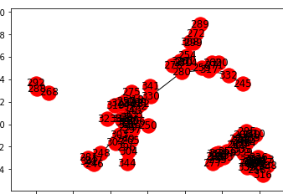
Finding Social Circles
Connected Components
of an undirected graph is a subgraph in which any two vertices are connected to each other by paths, and which is connected to no additional vertices in the supergraph.

Slide 10
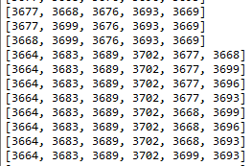
Finding Social Circles
Cliques
is a subset of vertices of an undirected graph such that every two distinct vertices in the clique are adjacent; that is, its induced subgraph is complete.
# params
cliqueSize = 5
tooLittleFriendsInCircleThreshold = 5
tooManyNodesThreshold = 65

Slide 11
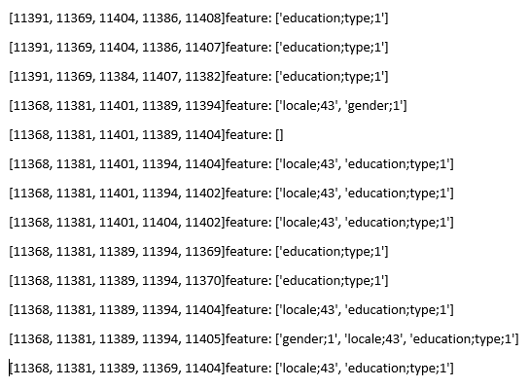
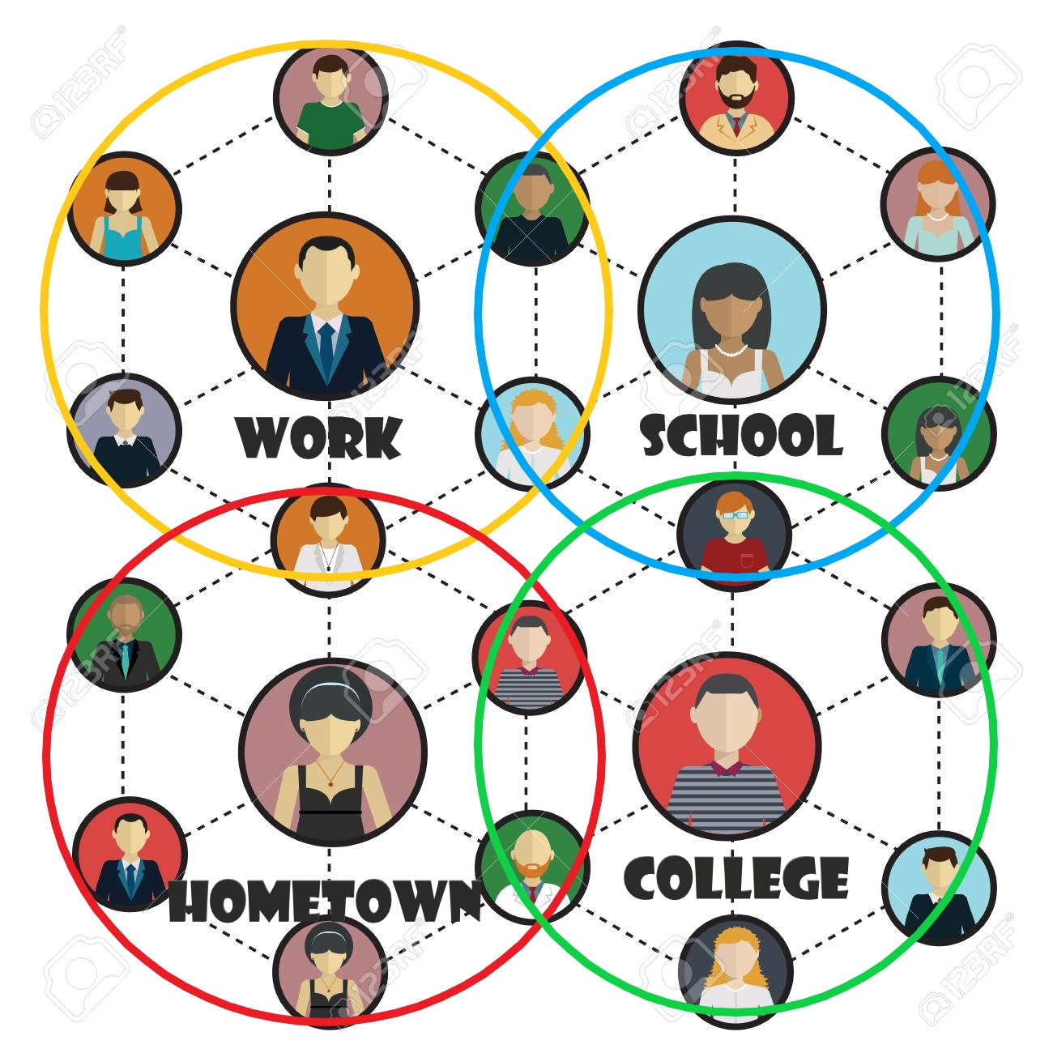
Output of Circles
Success Rate: 90.32%

Slide 12

Future Scope
Currently our features are centered around education, location and other physical parameters. Capturing features such as common interests, emotions and social agenda could help form more accurate circles.

Slide 13
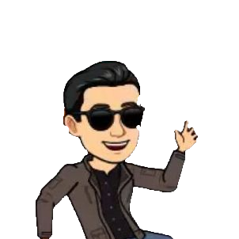

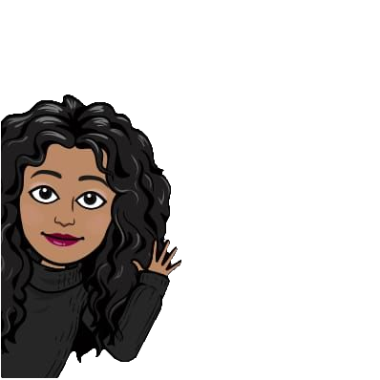

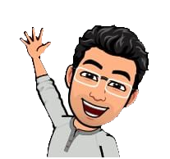
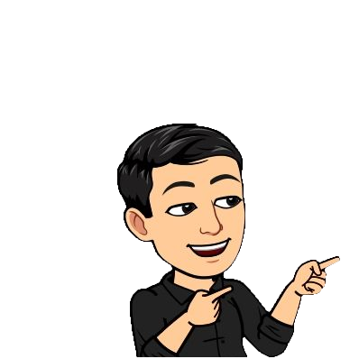
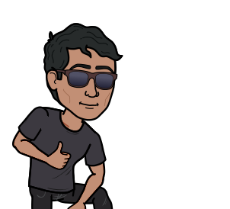
Future Scope
.
Grad School Friends
College Friends
College Friends

Slide 14
THANK YOU! 😉

